Slide 1
Digital Thinking and Innovation
Innovation through IoE

Slide 2
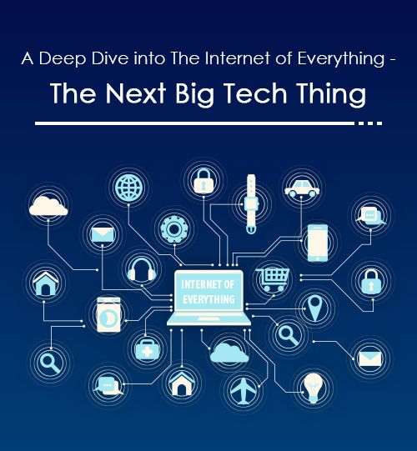
Introduction
This topic discusses how the Internet of Thing is taking place in the daily activities, which leads to the concept of Internet of Everything, where everyone and everything is simply connected.

Slide 3
Learning Outcomes for the Lecture
At the end of this lecture you will be able to:
Define Internet of Things
Explain how the IoT improves daily activities
Explain the benefits of IoT
Explain the issues relating to IoT
Define Internet of Everything

Slide 4
Content
Internet of Things
The Benefits of IoT
The Issues Evolving IoT
Internet of Everything

Slide 5
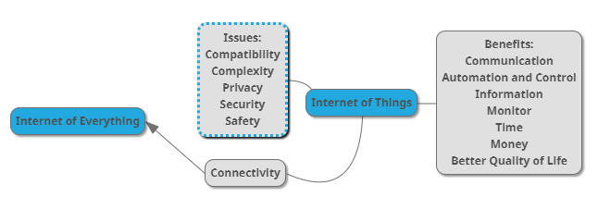
Mind Map

Slide 6
Learning Outcomes for the Lecture
At the end of this lecture you will be able to:
Define Internet of Things
Explain how the IoT improves daily activities
Explain the benefits of IoT
Explain the issues relating to IoT
Define Internet of Everything

Slide 7
Internet of Things
The dissolution of boundaries between the virtual and physical worlds
The Internet has already reached a tipping point
More objects are now digitally connected than people
Online artifacts include everything from kitchen appliances, door locks, home alarm systems, networked weather sensors, automobiles, energy system sensors, and industrial control systems (ICS)

Slide 8
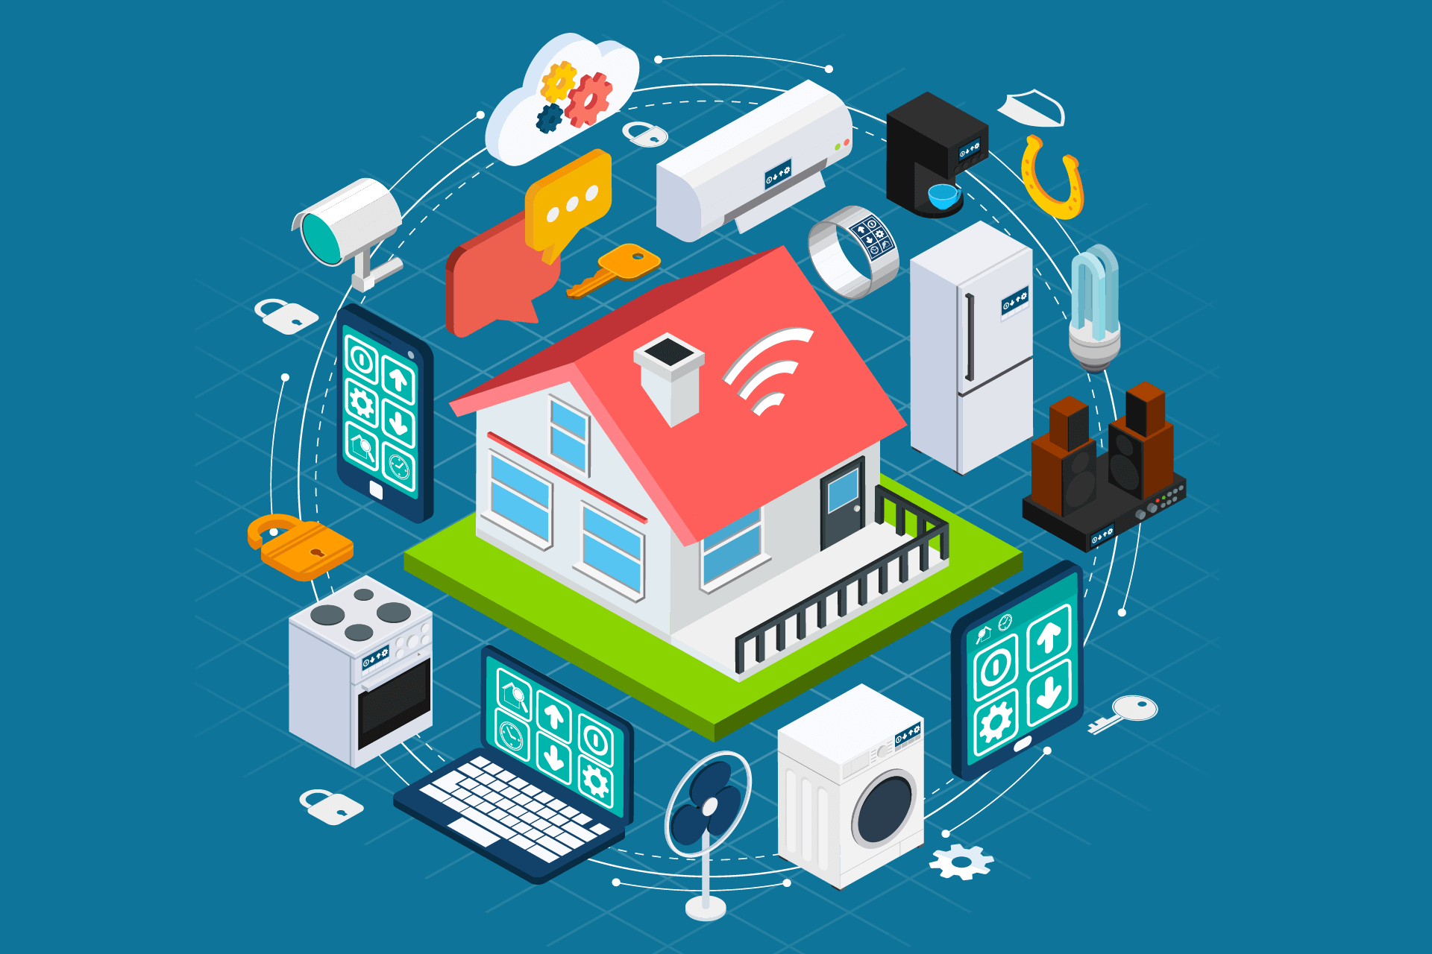
Internet of Things
“Internet Users” Are Not People

Slide 9
Internet of Things
Internet of Things refers to the real-world physical objects that are connected to the Internet and, therefore, to all other physical objects
Their primary purpose is not communication among people or access to information such as news, knowledge, business data, and entertainment
They are geared toward keeping systems functional by sensing and analyzing data and autonomously controlling devices.

Slide 10
Internet of Things
Already measured in billions, there will soon be on the order of 20 billion or more material objects online
Increases in object connectivity will result in new industries creating interconnected products embedded with chips, sensors, actuators, and radiofrequency identification (RFID) capability

Slide 11
Internet of Things
This phenomenon will have significant implications for:
Economic growth
Individual rights
Business models
Governance

Slide 12
Learning Outcomes for the Lecture
At the end of this lecture you will be able to:
Define Internet of Things
Explain how the IoT improves daily activities
Explain the benefits of IoT
Explain the issues relating to IoT
Define Internet of Everything

Slide 13

Group Discussion
Watch and discuss the content of the video:
https://www.youtube.com/watch?v=EKRVILAohck

Slide 14
The Digitization of Everyday Objects
“Why would anyone want a computer embedded in all the objects?” – an outdated question
People wear connected fitness bracelets and rely on connected glucose monitors
Homes contain connected coffee makers and door locks
Stores house RFID-embedded retail items
vehicles contain networked sensors that detect collisions or monitor traffic conditions
work environments use networked energy systems, manufacturing robots, and security systems

Slide 15
Emergent Cyber-Physical Systems
Some emerging cyber-physical systems are not enhancements to existing material structures but entirely new innovations
3D printing
Augmented reality
Some types of advanced robotics
Help to elucidate common technical features of cyber-material hybrids and emerging policy issues

Slide 16
Autonomy and Machine Learning
Humans can sometimes be entirely excised from systems, once operational
This quality of autonomy is “to generate, exchange and consume data with minimal human intervention
Some technology are designed ex ante to require no human intervention, as such, they are sometimes described as machine-to-machine implementations

Slide 17
Learning Outcomes for the Lecture
At the end of this lecture you will be able to:
Define Internet of Things
Explain how the IoT improves daily activities
Explain the benefits of IoT
Explain the issues relating to IoT
Define Internet of Everything

Slide 18
Benefits of IoT
Communication: Encourages the communication between devices, also famously known as Machine-to-Machine (M2M) communication
Automation and Control: Physical objects are connected and controlled digitally and centrally with wireless infrastructure. Without human intervention, the machines are able to communicate with each other leading to faster and timely output.

Slide 19
Benefits of IoT
Information: More information helps making better decisions
Monitor: Being able to monitor can further provide more information that could not have previously been collected easily
Time: The machine-to-machine interaction provides better efficiency, hence; accurate results can be obtained fast

Slide 20
Benefits of IoT
Money: Optimum utilization of energy and resources can be achieved by adopting this technology and keeping the devices under surveillance:
Bottlenecks
Breakdowns
Damages
Better Quality of Life: All the applications of this technology culminate in increased comfort, convenience, and better management, thereby improving the quality of life.

Slide 21
Learning Outcomes for the Lecture
At the end of this lecture you will be able to:
Define Internet of Things
Explain how the IoT improves daily activities
Explain the benefits of IoT
Explain the issues relating to IoT
Define Internet of Everything

Slide 22
Issues Evolving IoT
Compatibility
Complexity
Privacy
Security
Safety

Slide 23
Learning Outcomes for the Lecture
At the end of this lecture you will be able to:
Define Internet of Things
Explain how the IoT improves daily activities
Explain the benefits of IoT
Explain the issues relating to IoT
Define Internet of Everything

Slide 24
Internet of Everything
As more real-word physical objects the more reliance we become with the virtual/digitization
Data we obtained from the computerized everyday objects such as smartwatch, planner, etc.
Internet of Everything refers to all the connections that would be made; and it won’t work like today’s connectivity where speed and capacity will not be as limited
Data created would be so massive that only Artificial Intelligence system will be able to manage

Slide 25
Internet of Everything
Everything will be so connected that some would say there is a potential of a fully electronic ecosystem
People are connected
Objects are connected
Animals are connected
Everything is connected!
In short, we are making our planet and near space, smart and connected

Slide 26
Privacy Concern
All of our “moves” will be recorded in exchange to obtain the most out of the object
Many young people are already compromising their privacy
It is expected that this will become a norm in the future generation
Thus deploying IoE is likely

Slide 27
Group Discussion
Watch and discuss the content of the video:
https://www.youtube.com/watch?v=mz7c7mJESGE

Slide 28
Summary
Internet of Things
The Benefits of IoT
The Issues Evolving IoT
Internet of Everything

Slide 29
Questions and Answer
Q & A

Slide 30
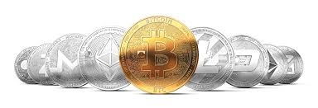
Next Lecture
Digital Currencies and Blockchain

